Slide 1

Object Oriented Programming with Java Class: Exception handling
Stelios Sotiriadis

Slide 2
Agenda
Part 1: Introduction to Exception Handling
Errors vs Exceptions
Run-time errors
Types of Exceptions
Part 2: Java samples
Common examples of Exceptions in Java

Slide 3

Part 1: Introduction to Errors and Exceptions

Slide 4
What is a run-time error?
A runtime error occurs while a program is running or when you first attempt to start the application.
What can cause a run-time error?
There's a bug in the software.
Memory or another system resource is in short supply.
Incorrect input, e.g. you enter a number in a String variable

Slide 5
Exceptions
Definition:
An exception is an abnormal program behaviour or an event, which occurs during the execution of a program, that disrupts the normal flow of the program's instructions.

Slide 6

Quiz 1
Based on your in-class or in-lab experiences, can you think of an example of an exception?
* Divide a number by zero
* Access an array index that is negative, greater than,
or equal to the length of the array
* Invalid user input

Slide 7
Errors versus Exceptions
Errors represent irrecoverable conditions.
For example, if the Java virtual machine (JVM) is running out of memory and there are memory leaks.
Errors are usually beyond the programmer's control
Exception: Exception indicates conditions that a reasonable application might try to catch.

Slide 8

What is an Exception Handling?
Definition:
Exception handling ensures that the flow of the program doesn't break when an exception occurs.
Exception handling in Java:
A way to handle run-time errors so that the regular flow of the application can be preserved.
Java Exception Handling is a mechanism to handle runtime errors such as ArrayIndexOutOfBoundException, IOException and others.

Slide 9
Exception Handling in Java
Object
All exception and error types are subclasses of class Throwable, which is the base class of the hierarchy.
Throwable is the superclass of all errors and exceptions in the Java language.
Throwable
Exceptions
Errors
Checked Exceptions:
IO Exceptions
Unchecked Exceptions:
VM Errors

Slide 10
Built-in user Exceptions
Built-in exceptions are the exceptions that are available in Java.
These exceptions are suitable to explain certain error situations.
Checked Exceptions: Compile-time exceptions that are checked at compile-time by the compiler.
Unchecked Exceptions: The compiler will not check these exceptions at compile time.

Slide 11
Quiz 2
Can you think of an example of:
A checked exception?
An unchecked exception?
You try to open a file that does not exist
(FileNotFoundException)
You try to access an array index that does not exist
(ArrayIndexOutOfBoundsException)

Slide 12

Part 2: Exception Handling with Java

Slide 13
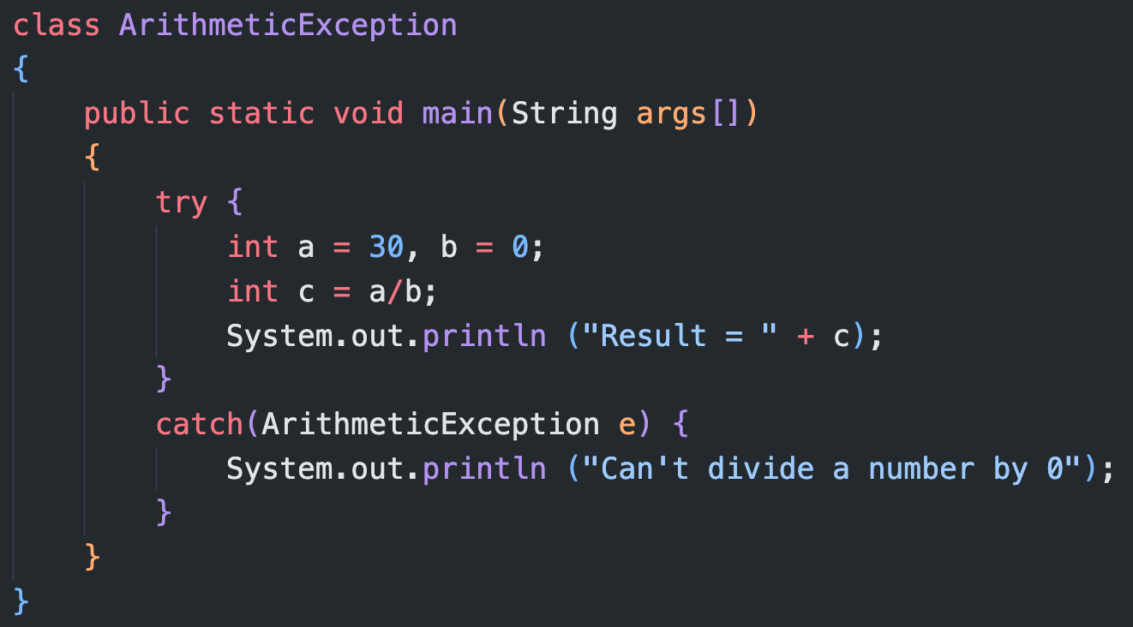
What is the output (1/4)?
Output:
Can't divide a number by 0

Slide 14
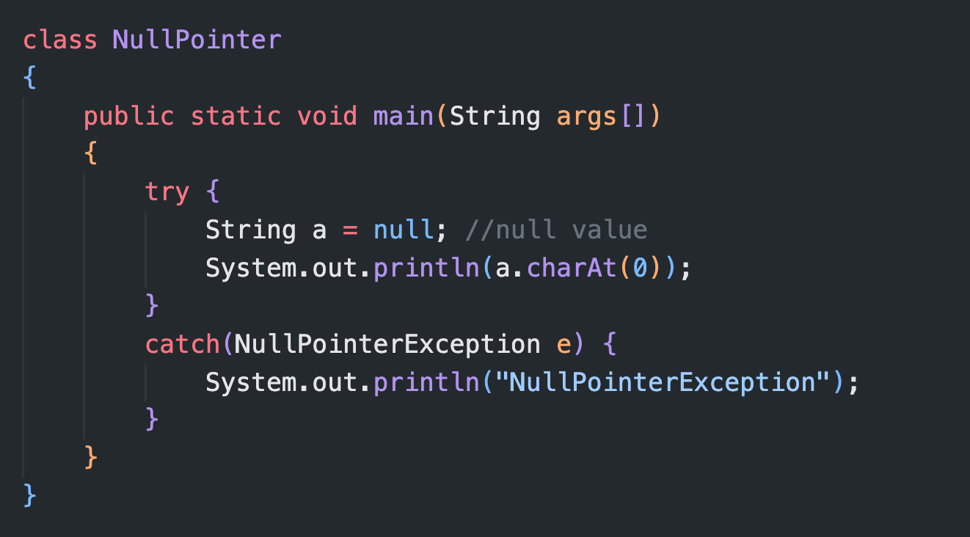
What is the output (2/4)?
Output:
NullPointerException

Slide 15
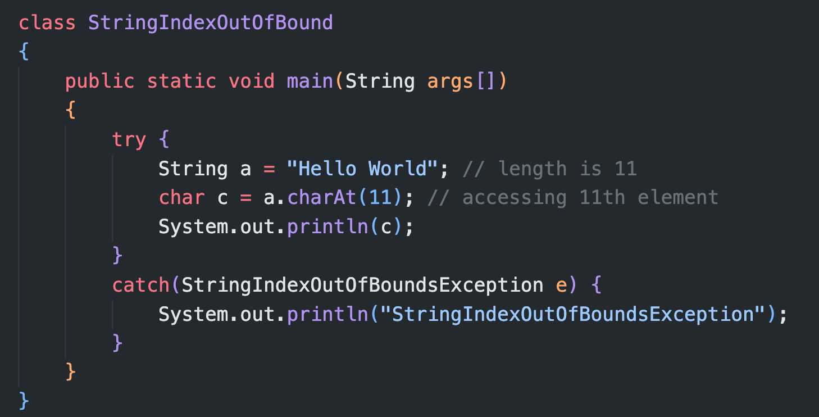

What is the output (3/4)?
last_index = length - 1
Output:
StringIndexOutOfBoundsException

Slide 16
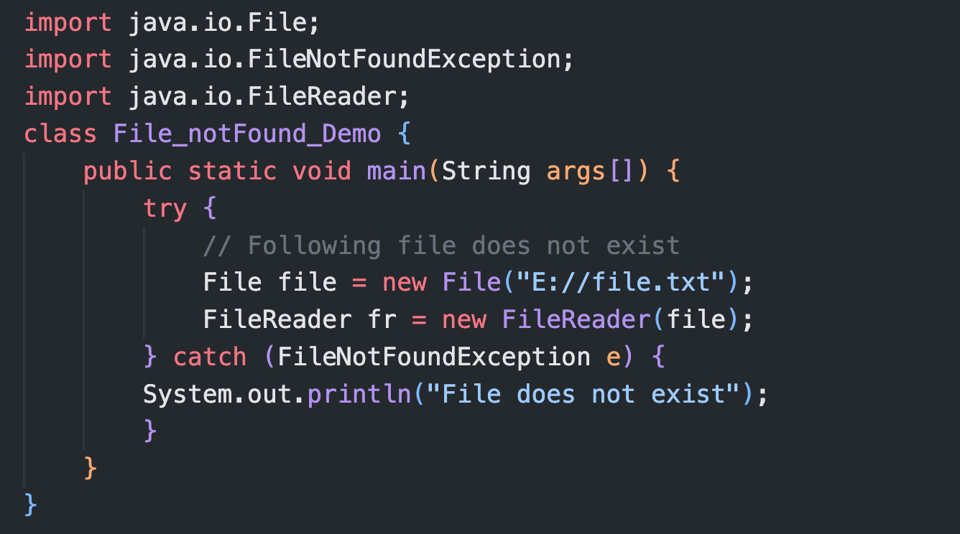
What is the output (4/4)?
Output:
File does not exist

Slide 17
Quiz 3
Can you fill the spaces?
class ArrayIndexOutOfBound
{
public static void main(String args[]) {
{
int a[] = new int[5];
a[ ] = 9; // Accessing 7th element of the array
}
(ArrayIndexOutOfBoundsException e){
System.out.println (” ");
}
}
}
try
6
catch
Array Index is Out Of Bounds

Slide 18
Summary
What can cause a run-time error?
There's a bug in the software.
Exception indicates conditions that a reasonable application might try to catch.
Checked Exceptions: Compile-time exceptions that are checked at compile-time by the compiler.
Unchecked Exceptions: The compiler will not check these exceptions at compile time.

Slide 19
End of Class
Take home:
What is an Exception?
What is an error?
What are the Exceptions types in Java?
What is a checked and unchecked Exception?
Can you develop a Java script for a build-in Exception such as ArrayIndexOutOfBoundsException?

Slide 20
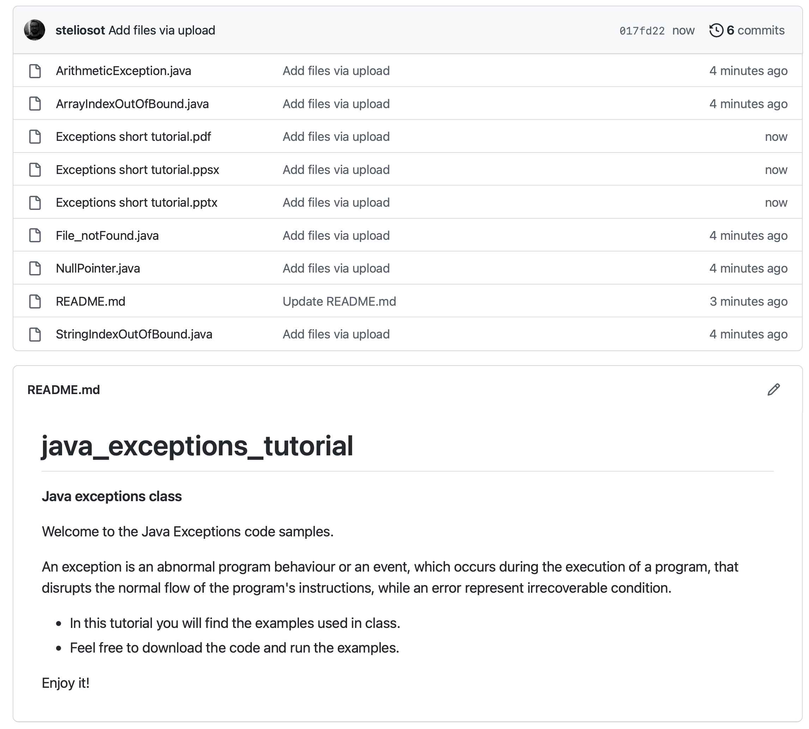

To do
Code samples are online:
1. Clone the GitHub repo
2. Run the samples
3. Customise the code

Slide 21
Q&A
Any questions?

Slide 22
Questions?
Useful resources to check:
Java documentation on Exception Handling:
https://docs.oracle.com/javase/tutorial/essential/exceptions/index.html
To explore at home:
Advantages of Exceptions:
https://docs.oracle.com/javase/tutorial/essential/exceptions/advantages.html

